Slide 1
Wastewater Injection Wells and Earthquakes in Oklahoma, USA
Josh Gilberg

Slide 2
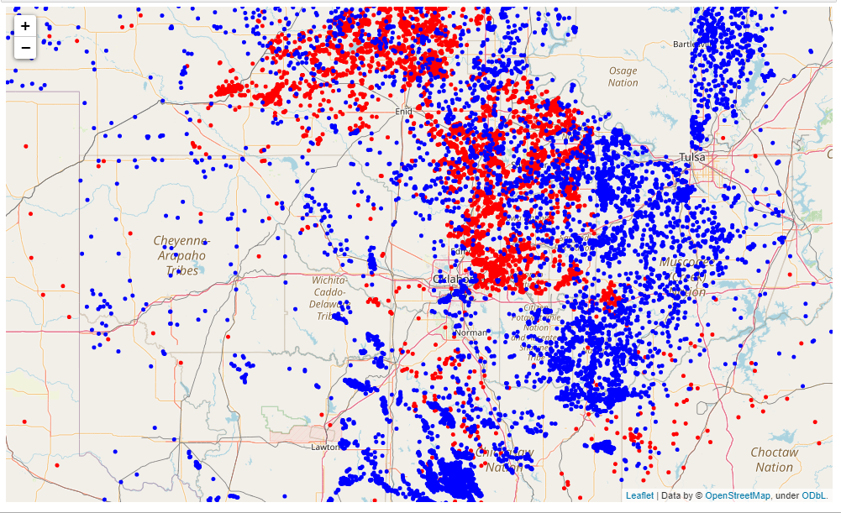
Project Background
Beginning in 2009, the frequency of earthquakes in the U.S. State of Oklahoma rapidly increased from an average of fewer than two 3.0+ magnitude earthquakes per year since 1978 to hundreds per year in 2014, 2015, and 2016. Thousands of earthquakes have occurred in Oklahoma and surrounding areas in southern Kansas and North Texas since 2009. Scientific studies attribute the rise in earthquakes to the disposal of wastewater produced during oil extraction that has been injected deeply into the ground. (Wikipedia)
Injection wells are utilized to dispose of fluid created as a byproduct of oil and gas production activities. Likewise, hydraulic fracturing, ie "fracking", produces large byproducts of water. This byproduct is then injected deep back into the earth via disposal/injection wells.
Can the future volume of earthquakes be predicted from the number of injection wells and the volume of wastewater injected back into the subsurface?
Locations of wells and earthquakes

Slide 3
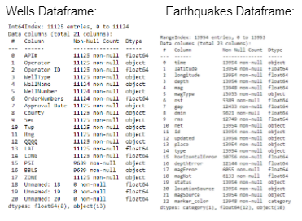
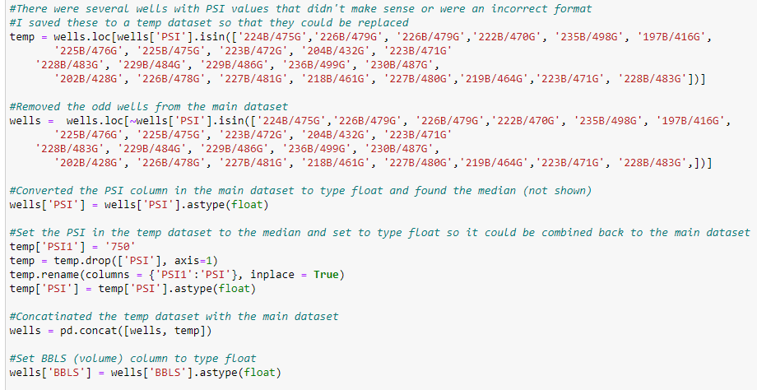
Data Wrangling
The approach for data wrangling was to remove all unnecessary features and investigate and fix all null values.
Every row for each feature should have a relevant value and each feature should have the correct Dtype for analysis.
When looking at the Wells dataframe on the left, the ‘PSI’ and ‘BBLS’ features not only had several thousand null values, but the dtype is object instead of float
In order to take care of this it was necessary to remove all commas from the values so that it could be converted to float.
Even after commas were removed it still wouldn’t convert so I looked at the unique values.
There were quite a few odd values with this format: '202B/428G', '226B/478G','227B/481G', '218B/461G'.
Removed those values to a temporary dataframe
Changed the type of the rest of the remaining rows to float and found the median.
In the temporary dataframe I replaced the odd values with the median
Converted it to float, and merged it with the main dataset. Now there were no null values and it was the correct dtype.
Code Snippet Showing Interesting Data Wrangling

Slide 4
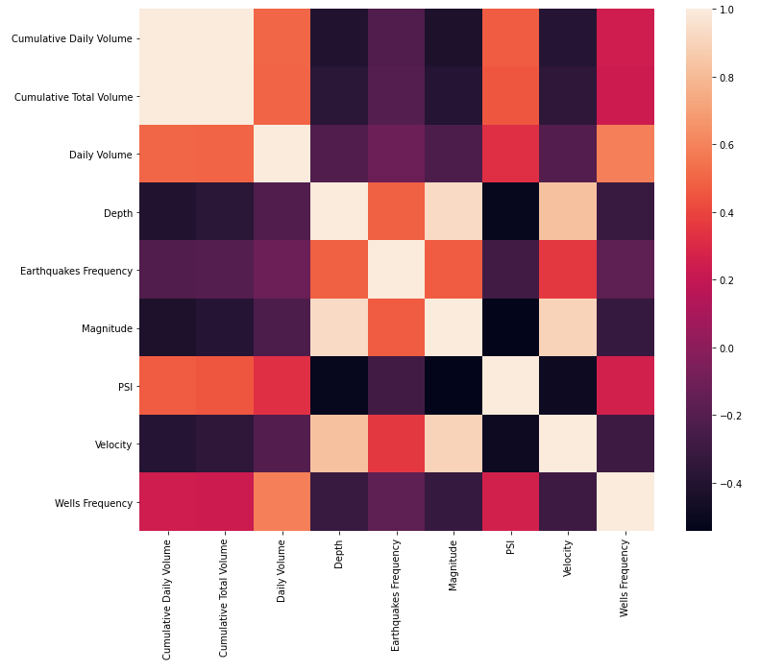
Exploratory Data Analysis
For exploratory data analysis I did preliminary plotting to see the relationships between the features and the two dataframes.
This is very easily done with pandas profiling to see histograms of each feature as well to see if you have any remaining null or extreme values.
After exploring with pandas profiling I made several plots exploring the features changing over time.
Pearson Correlation Heatmap

Slide 5
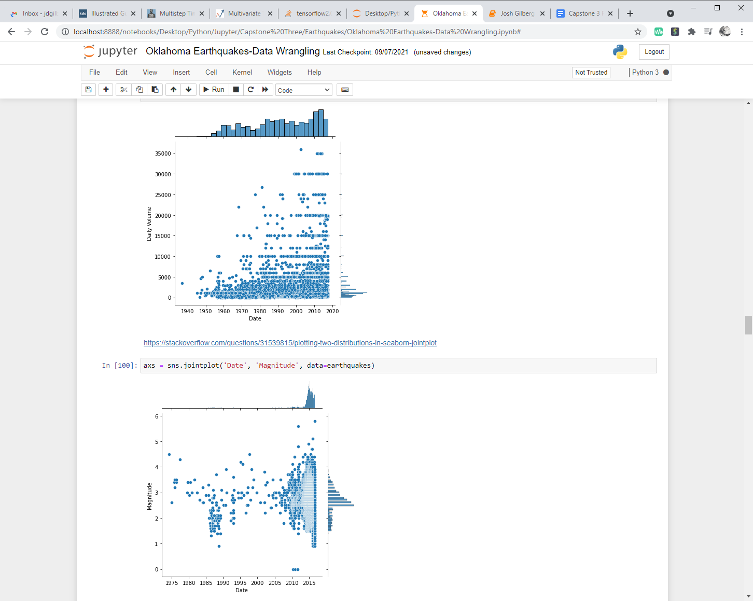
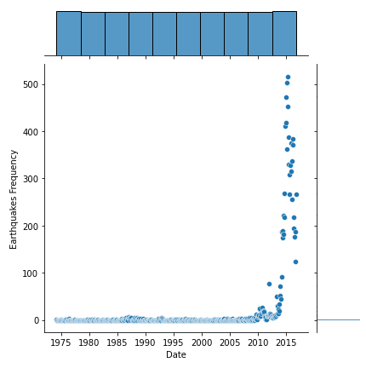
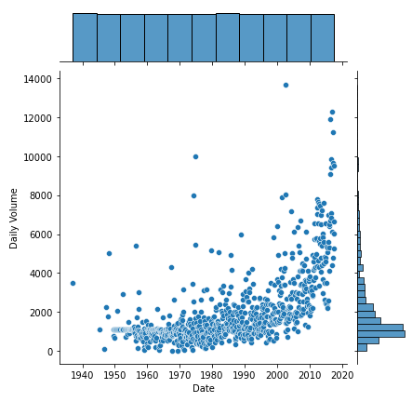
Exploratory Data Analysis
Earthquake Magnitude Over Time
Earthquake Frequency Over Time
Daily Volume per Month Over Time
Daily Volume Rate Over Time

Slide 6
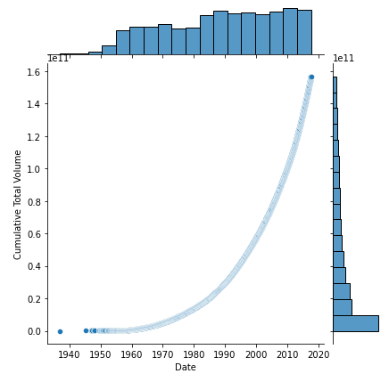
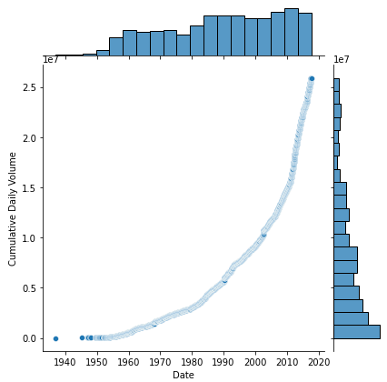
Feature Engineering
I suspected that part of the reason for the increase in earthquakes was not just more wells, but the cumulative effect of the water injection.
Calculated the cumulative volume injected over time based on each injection well’s daily volume rate.
I summed the individual daily rates and shifted them down a row.
This made it so ‘Cumulative Daily Volume’ was the total rate of all previous wells.
I also calculated a ‘Days Since Last Well’ feature to take care of the time component.
Then all I had to do was multiply these together and sum them down the column for the ‘Cumulative Total Volume’ over time.
Cumulative Total Volume
Cumulative Daily Volume

Slide 7
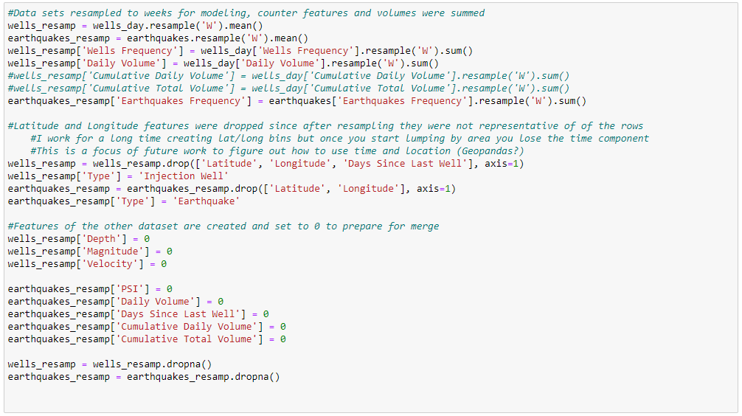
Preprocessing
In order to prepare the datasets for modeling there were several steps taken. The first was to resample the dataset into larger regularized bins. After the bins were created all columns present in the other dataset were created and populated with zeros to make the dataset merge easier.
This resample was redone several times during modeling to find the best size of bin. The options that were tried were: 1 day, 3 days, 5 days and 1 week.
Anything larger than one week provided too few samples. The binning that gave the best solution was 5 days.
After the resample the two datasets were combined into one. The next process was to one hot encode the ‘Type’ features. The types differentiate each row as an earthquake or an injection well.
Code Snippet Showing Timing Resample

Slide 8
Preprocessing
The final step before modeling was to split into train/test sets and scale the features.
Since I was trying to use the features to predict the future I couldn’t use a standard train/test split so I manually choose dates for a split point.
This was extensively tested for optimal results.
I wanted to make sure that the training data saw at least a portion of the ramp up in earthquakes so it would know what to look for in the other features, but not so much that the testing data was too small
Once I closed in on the optimal split point the differences in even a month were rather drastic.
Some plot displays of the split results are presented below
You can see in the figure to the right that the ramp is quite drastic and selecting the right amount of data to train on was crucial
Example of Choosing Train/Test Split Time

Slide 9
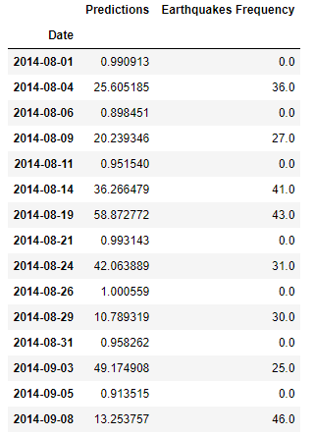
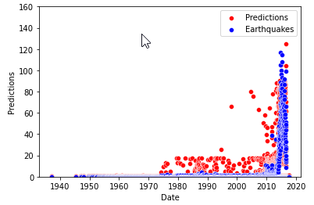
Modeling
For the modeling portion I planned to use a dense neural network. I tested several versions, 2 vs 3 hidden layers, 500 vs 750 vs 1000 nodes, dropout vs no dropout and rate, and settled on a 2 hidden layer, 500 node with 25% dropout model. This model ended up giving about the same results as a 2 or 3 layer 1000 node model but ran in ¼ the time.
The accuracy output of the model gave an accuracy score of 0.5384615659713745 but it seems to be performing better than this. If you look at the test split results the model never actually predicts a zero but the output is around 1 or below. I believe this indicates that the model quite accurately predicts whether there will be a burst of earthquakes or not.
Full Dataset Predictions vs Earthquakes
Neural Network Predictions vs Ground Truth

Slide 10
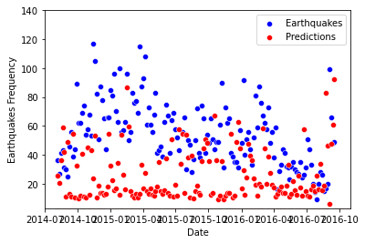
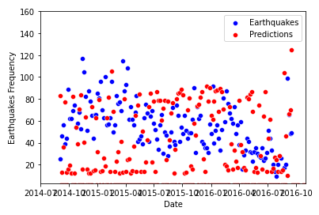
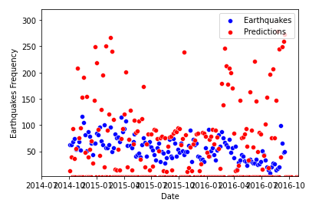
Modeling
As mentioned above, the train/test split dates made quite a difference on the test predictions.
When the split was August 1st, 2014 the model seems to drastically underestimate the results and is very hesitant to predict a frequency of greater than 60 earthquakes per period.
The training data did not see enough of the increase to know the predictions should be higher
When you move forward two months to October 1st, 2014 it appears that the model is given too much information and it expects the ramp to continually go upward.
It drastically overestimates the number of earthquakes, you’ll notice that the vertical scale is double that of the other plots to be able to see the predictions.
It appears that the month right in the middle, September 1st, 2014 is the perfect split.
It sees enough of the ramp up to make more accurate predictions but doesn’t way over predict.
Test Preds August 1st, 2014 Test Preds September 1st, 2014 Test Preds October 1st, 2014

Slide 11
Future Work
-Figure out what happened ~1975 to cause instability in the training data
-Figure out a spatial component, multiple groupbys so you can have geographical bins but also save the time component
-During the modeling process I spent a lot of time trying to create a LSTM model without much success. This would be a step up in accuracy due to it’s stepwise nature of predictions.

